Slide 1


Eco-Friendly Noise-Isolating Door Using Recycled Cigarette Butts

Slide 2
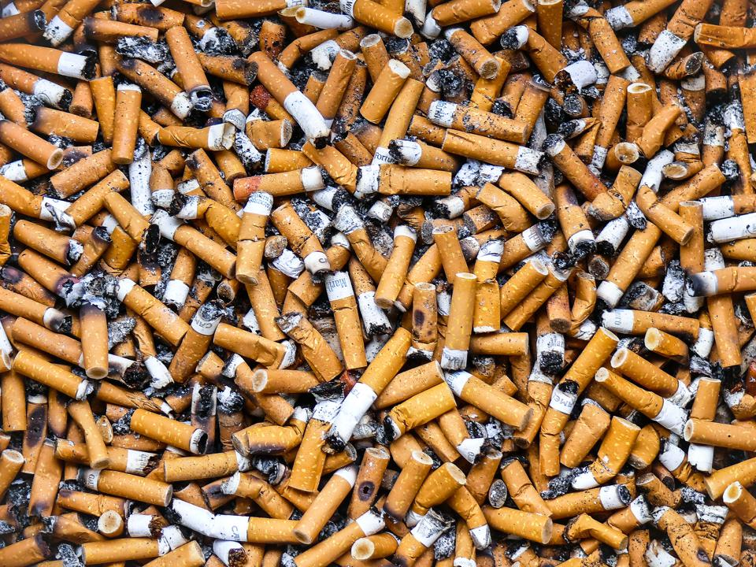
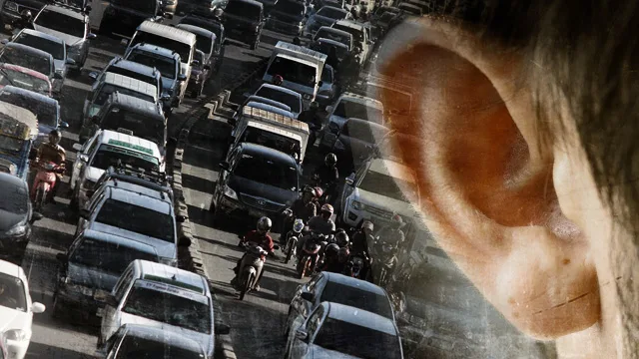

Problem statement
In today's rapidly urbanizing world, environmental and quality of life issues are becoming increasingly pressing
Cigarette butts are a major environmental pollutant
Urban noise pollution is also a growing concern, affecting the quality of life
Traditional recycling methods for cigarette butts are inadequate and not widely implemented

Slide 3



Proposed Solution
recycle cigarette butts into composite materials for noise-isolating doors featuring smart technology (face ID locks, mobile app connectivity).
Solution
recycle cigarette butts into composite materials for noise-isolating doors featuring smart technology (face ID locks, mobile app connectivity).
Value proposition
Create sustainable, innovative solutions to improve urban living and promote environmental conservation
Mission

Slide 4
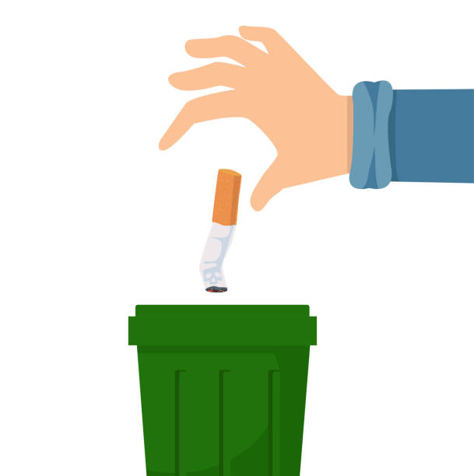

Butts to doors
Our blockchain-based reward system incentivizes the collection and proper disposal of cigarette butts
Promotes environmental sustainability by encouragingcommunity members to properly dispose of cigarette butts, turning waste into valuable token
This system leverages blockchain technology to ensure transparency, security, and efficiency in rewarding participants with tokens that can be traded for products or services

Slide 5


Logo & value proposition
Our product effectively addressing the problem of discarded cigarette butts and environmental pollution .
We are the first in the Tunisian market to offer noise-isolating padded doors made from recycled cigarette butts, integrated with smart technology guaranteeing security.
By involving the community in recycling efforts and rewarding them with blockchain tokens, we foster community engagement.
2
1
3

Slide 6
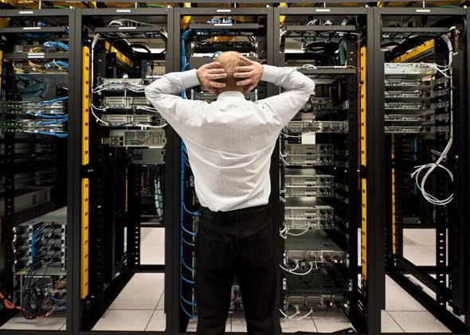
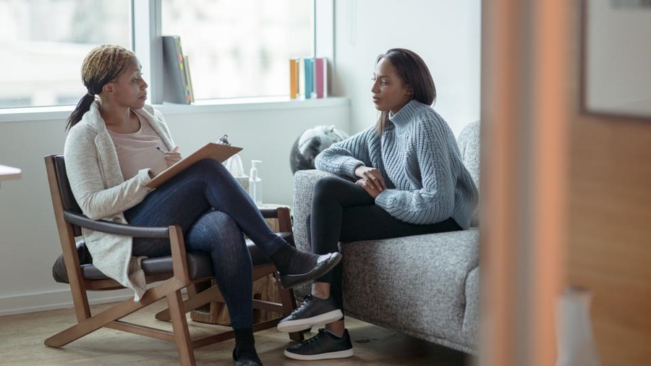
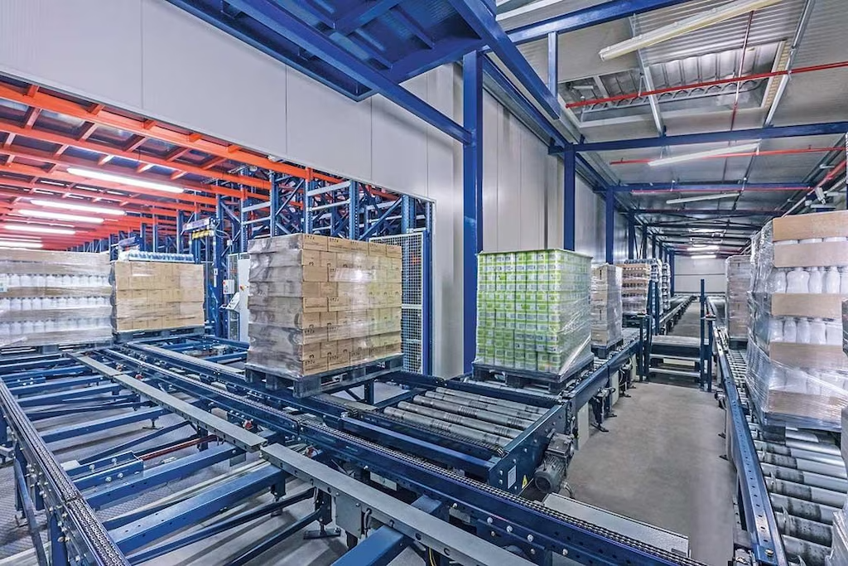


Market opportunity
Universities and companies with servers that need to be secured and noise-reduced.
Psychiatrist , lawyers etc ..
Factories and warehouses
Office Buildings
Hospitals

Slide 7


Competetive landscape
Limited competition in the market for noise-isolating doors using recycled materials
Potential competition from traditional noise-isolating solutions and smart home technology providers

Slide 8



BUSINESS MODEL & HEDERA INTEGRATION
Revenue from sales of noise-isolating padded doors
Blockchain-based reward system for cigarette butt collection using Hedera tokens
Potential partnerships with cigarette manufacturers and waste management companies

Slide 9




Impact
Reduce noise pollution and improve working conditions in factories and companies
Promote sustainability by recycling cigarette butts and reducing waste
Engage the community in environmental conservation efforts
Secure sensetive data and discrete conversations

Slide 10
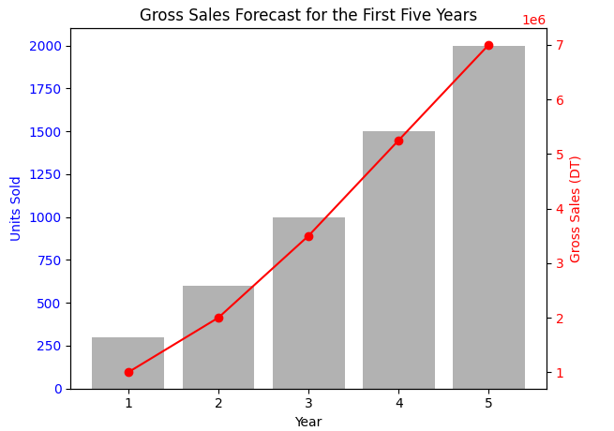
FINANCIAL PROJECTION

Slide 11
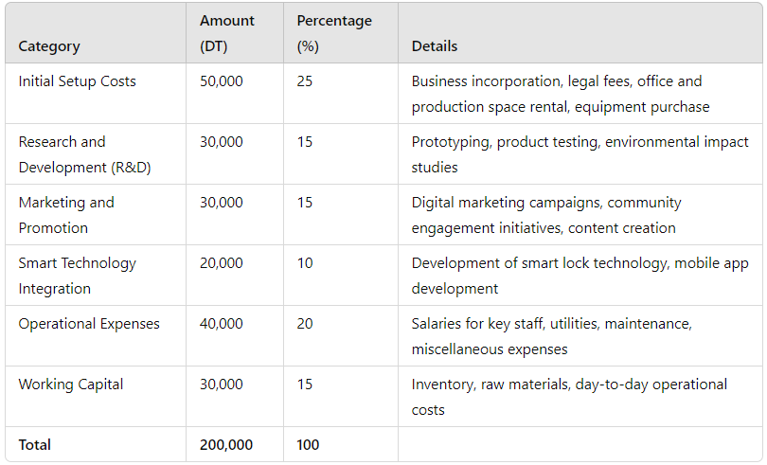
ASK
To successfully launch and grow our innovative project, we have identified a total funding requirement of 200,000 DT. This funding will be utilized to cover various aspects of the business, from initial setup costs to marketing and operational expenses

Slide 12
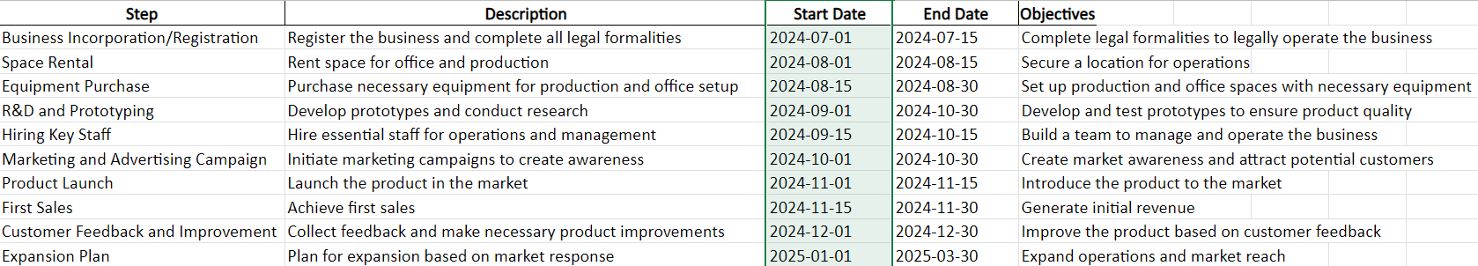
Roadmap

Slide 13
Disease history
Discovery of the disease
Early research
First treatment
Milestone discoveries
Breakthrough treatment
Epidemic outbreak
Current research
Future directions

Slide 14
Thanks

